Slide 1



異なる親和性でのPt/n-アルカン界面の 界面熱抵抗と表面液体構造の相関
日本機械学会熱工学コンファレンス2022
0
Surface Liquid Structure Correlation with Interface Thermal Resistance of Pt/n-alkane Interface at Different Affinities
○Qing-Yao Luo, Donatas Surblys, Hiroki Matsubara, Taku Ohara
Ohara Lab., Institute of Fluid Science, Tohoku Univ.
Oct. 8th, 2022

Slide 2

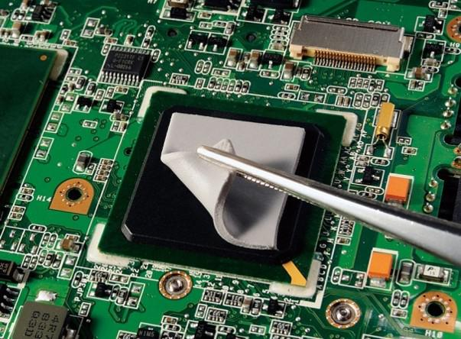
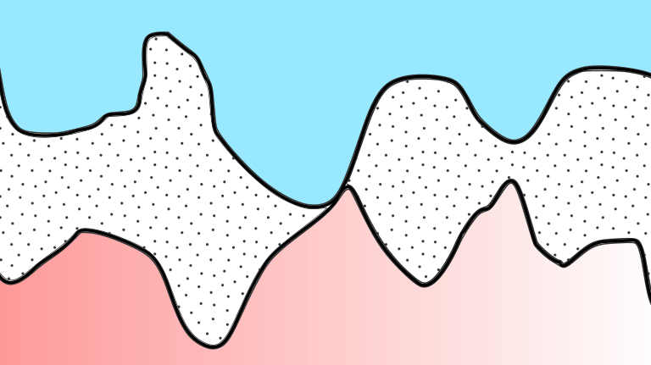
Background
Air
ITR is introduced
interface thermal resistance
©mccourier
Thermal interface material (TIM) fills the air–gap
ITR is decreased
TIM
Billions transistors in one chip
size of semiconductors
ρ of heat dissipation
significance of ITR
Understanding the thermal transport mechanism at the interface of
solid-TIM at nano scale is essential

Slide 3
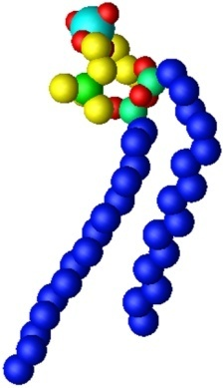
Background
TIM categories
liquid metal
1D/2D materials
polymer-based TIM
merits of polymer-based TIM
only highly conductive polymer
polymer matrix + filler
polymer + nanocomposites
mechanical properties
electronic properties
chemical properties
design flexibility
low price
conformability

Slide 4
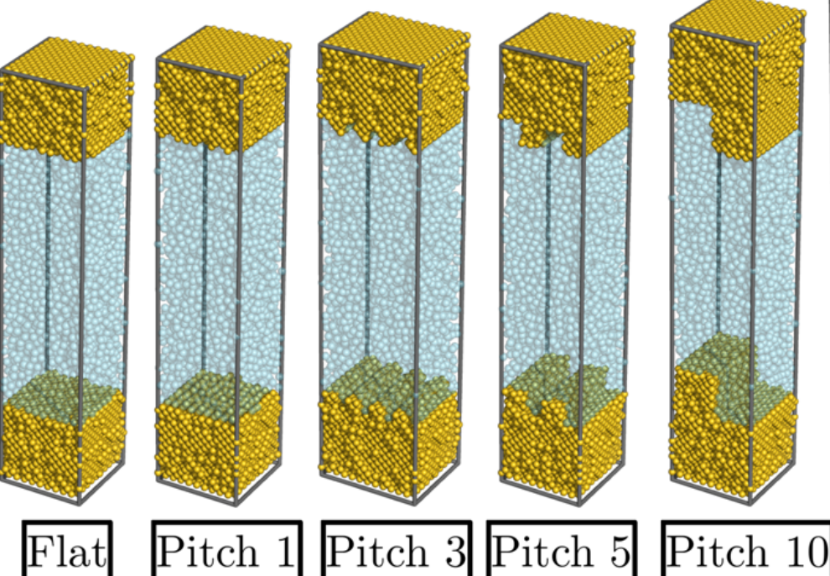
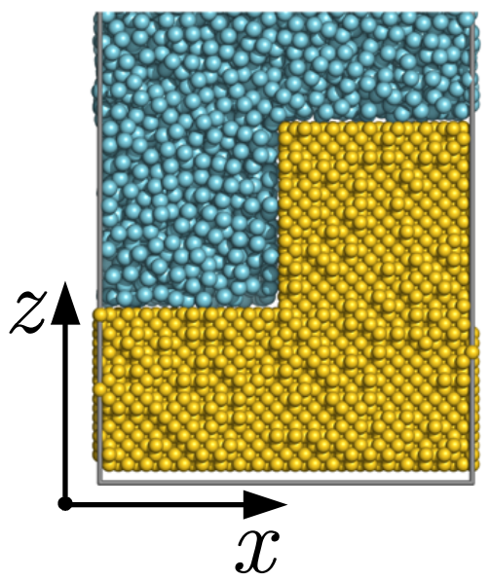
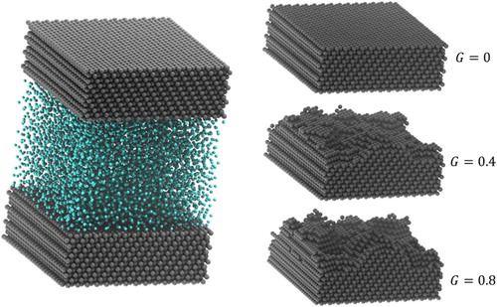
Existing Research on ITR of SLS System
work of our group
Au-Ar-Au system
Surblys D, et al. J. Chem. Phys. 150, 114705 (2019)
at low η: ITR_{large pitch}>ITR_{small pitch}
at high η: ITR_{rough surface}>ITR_{flat surface}
at η close to 1: highly ordered liquids increase ITR
ITR of polyatomic systems should be investigated even they are much more complex.
work of others
Ag-Ar-Ag system
Same fractal dimension and depth of roughness have same ITR and liquid density profiles.
Increase roughness won’t be helpful to decrease ITR at high η.
Frank M, et al. J. Chem. Phys. 151, 134705 (2019)

Slide 5
Existing Research on ITR of SLS System
work of our group
Au-Ar-Au system
Aim of this work:
Investigating surface liquid structure correlation with interface thermal resistance of Pt/n-alkane (TIM)/Pt systems at different affinities
Surblys D, et al. J. Chem. Phys. 150, 114705 (2019)
at low η: ITR_{large pitch}>ITR_{small pitch}
at high η: ITR_{rough surface}>ITR_{flat surface}
at η close to 1: highly ordered liquids increase ITR
ITR of polyatomic systems should be investigated.
work of others
Ag-Ar-Ag system
Same fractal dimension and depth of roughness have same ITR and liquid density profiles.
Increase roughness won’t be helpful to decrease ITR at high η.
Frank M, et al. J. Chem. Phys. 151, 134705 (2019)

Slide 6
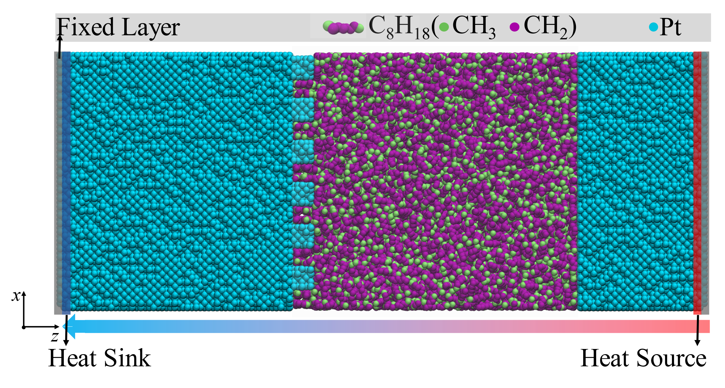

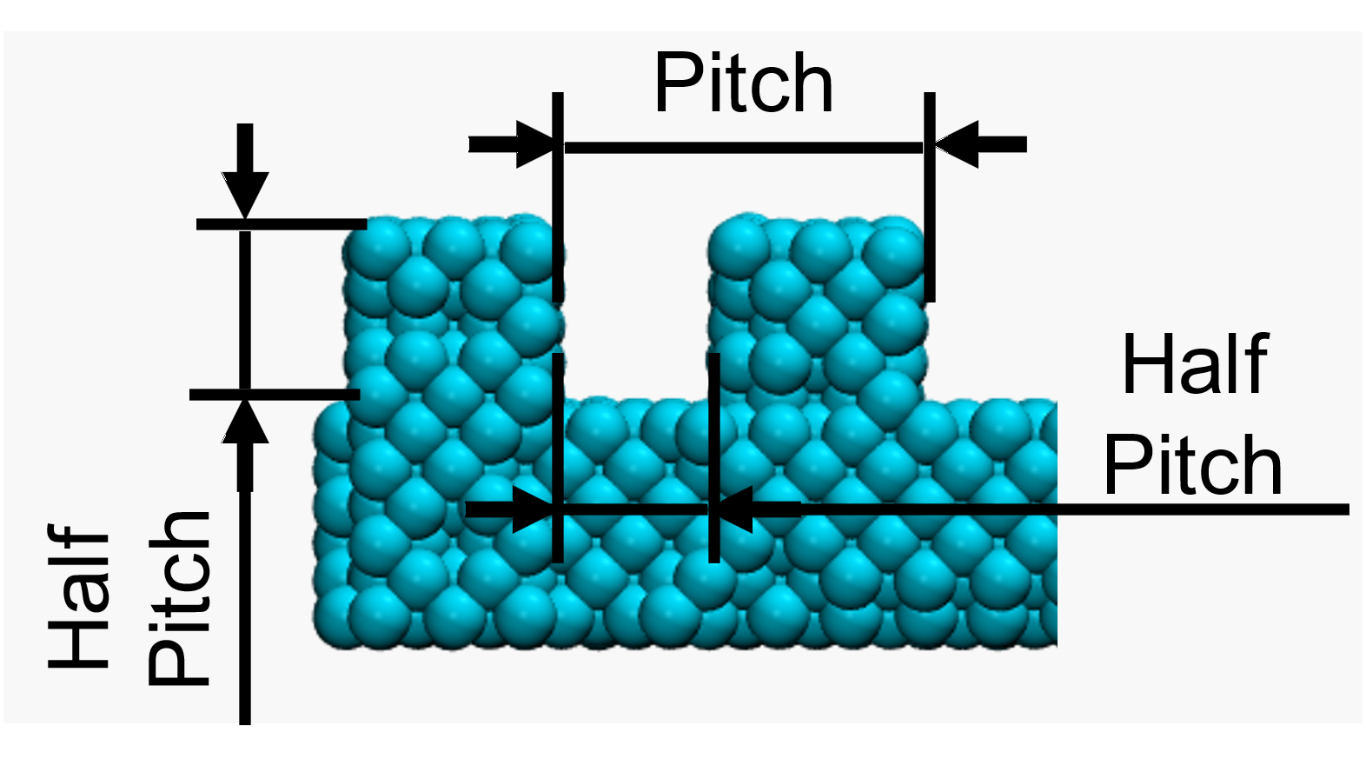
Simulation Systems
Side view of Pt-C₈H₁₈-Pt system
polymer chain-length:
8, 16, 24, 32
pitch length:
0
19.575005 Å
117.45003 Å
480K
19.575005 Å
540K
pitch 117.5
pitch 19.6
L_{x}=L_{y}=117.45 Å
210 Å < L_{z} < 340 Å
N_{united-atom} = 43200

Slide 7
Simulation Setting
Potential models
Simulation periods

Slide 8
Results
ITR at η of 0.1

Slide 9
Conclusion
ITR at η of 0.1

